Slide 1

DTX 495 - FINAL PRESENTATION
The UIUC Library System
Lakshmi Priya Diwakar, Araditta Iyer, Eddie Lim, Sophie Nikolov

Slide 2




Problem Space
You guys know you have a UIUC library
account right?
Yeah. We’re students, obviously
Nah, some students don’t know they have an account through which they could renew books on the website.
Students couldn’t find their account
Unknown to breadth of services available
How might we encourage students to independently manage their library accounts?

Slide 3
Project Timeline
September 12-13
Problem Definition
October 5
Ideation
October 10-13
1st Iteration
September 15-21
User Research
October 6-10 Prototyping Low Fidelity Wireframes
October 13-17
Finalizing High Fidelity Prototypes

Slide 4
Process
Ideation:
Google Doc, Voting
Figma (mid and high fidelity)
Strategy & Scoping:
Key Insights
Primary Research
Reviews and Observations
Student Interviews
Library UX team interviews
& User needs
Usability Test
Secondary Research:
Competitive Audit
Gut Check Test
Usability Analysis:
Heuristic Evaluation Accessibility Evaluation
1st Iteration Mockups
Final Mockups

Slide 5

User Research
Interviews
Have you borrowed books from the library? How was that process for you?
“No, I don’t need to. It’s intimidating to use the library website, there’s so much stuff on there. I feel discouraged from using it.”
TASK: reserve a book using the main library website
User scrolled past the book, stalled multiple times during book reservation and finally gave up.
Observations
GUT Check Test

Slide 6

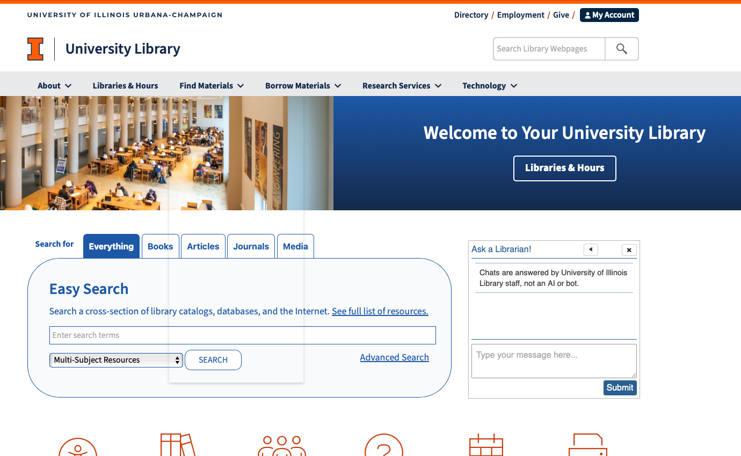

Slide 7
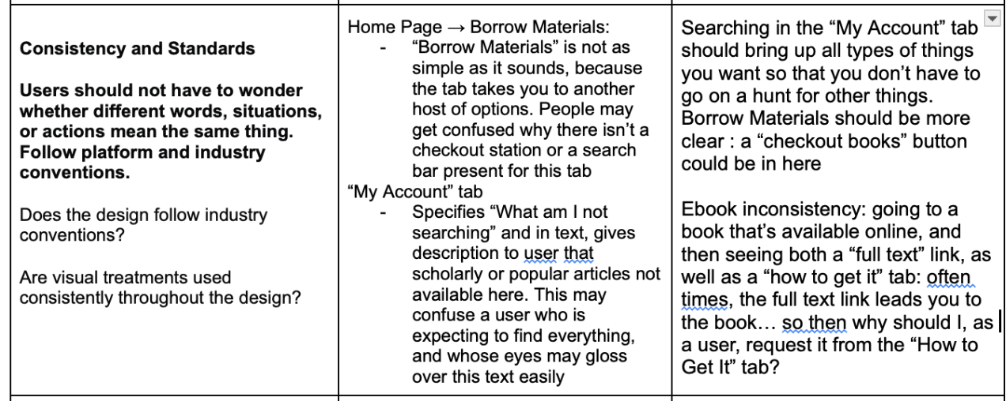
Heuristic & Accessibility Evaluations: Highlights

Slide 8
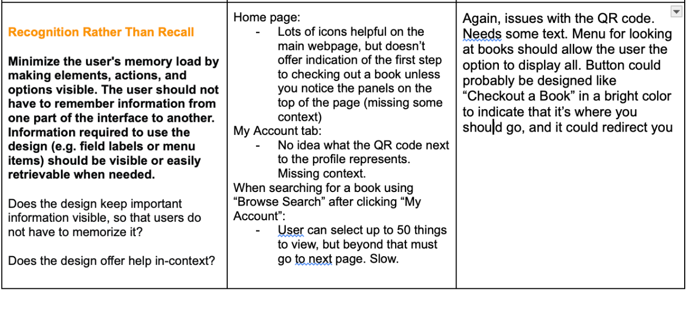
Heuristic & Accessibility Evaluations: Highlights

Slide 9

User Needs
USER RESEARCH
“In the landing page there should be more information for both reasons that people come here”
Cognitive load
Difficult to Navigate
STUDY SPACES
BORROW BOOKS
Fatigue

Slide 10


User Needs
“I saw that they recently made a change to the layout, but I wish I didn’t have to scroll so far down to be able to book study spaces”
Study Space Samuel
“There’s a lot of information that I don’t need when I see the results of my Easy Search(main library website feature)”
Bookworm Brianna

Slide 11
User Pain Points
Overwhelming Interface
Students found it provides too much information that they do not consistently need.
Accessibility of Information
Students felt that critical actions, like booking study spaces, were buried within the site and difficult to find.
Preference for Simpler Search Functions
While the search bar was appreciated for finding books, students struggled understanding the catalog structure and font readability.

Slide 12
Revised Problem Space
How might we encourage students to independently manage their library accounts?
Students couldn’t find their account
Unknown to breadth of services available
BECAUSE
Main library webiste is diffcult to navigate
How might we improve the library website to enhance user experience through simplified navigation and more accessible features?

Slide 13

Ideation
How we came up with our ideas?
Focused on the primary research question and key user pain points
Generated 20+ ideas collectively during our 5-minute individual brainstorming session
Ideas covered various screens of the library website, addressing diverse user needs.
Ranked ideas based on how they addressed key user pain points identified in the initial phase.
Identified 3 main ideas that directly solved common user challenges.
Focused on improving 3 screens: Main Page, Book Search Page, and Reserve Study Rooms Page.
We Chose the Finest!!
More Ideas, Better Solutions!!

Slide 14
Our Ideas..
SOPHIE
EDDIE
PRIYA
Bigger “My Account” Button
My Account Upper Left of page
QR Code explanation included
“Discover”:
“Check Out Books” Button
“Book Study Spaces” Button
“Rent Tech” Button
Display all Book Options for the menu when you get to “My Account”
“E Book Unavailable” vs “E Book Available” button clarification / redesign
Highlight account-related notifications with a banner or pop-up to boost account awareness.
Group similar services under dropdown menus and add icons for intuitive navigation.
Improve search functionality with auto-suggestions and query refinements.
Ensure full accessibility with WCAG standards, alt text, and ARIA labels.
Use consistent headings and font sizes for better content prioritization.
Add a visible feedback button or live chat for easy issue reporting.
Simplify UX by moving key features to the top and replacing "Ask a Librarian" with an icon.
Replace "Ask a Librarian Chat" with a "Reserve Study Rooms" option for more relevant functionality.
Simplify "Easy Search" by showing only "Everything" on the main page, with specific options moved under "Advanced Search."
Add dropdown menus for each library location in the "Reserve Study Rooms" section for easier selection.
Make "Library Spaces" the first option under the "About" section for quick access on mobile.
Include pictures near the "Collaboration Rooms" section to help students locate spaces more easily.

Slide 15
How might we help our users
How might we improve the library website to enhance user experience through simplified navigation and more accessible features?
FOCUS AREAS
FOR OUR USERS
Main Page
Book Search Page
Reserve Study Rooms Page
Simplified Features.
Reduced Cognitive Overload.
Increased and Satisfied User Engagement.

Slide 16
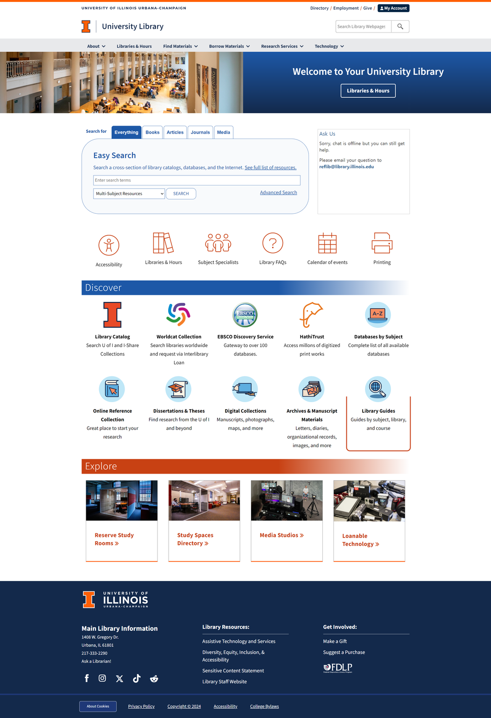
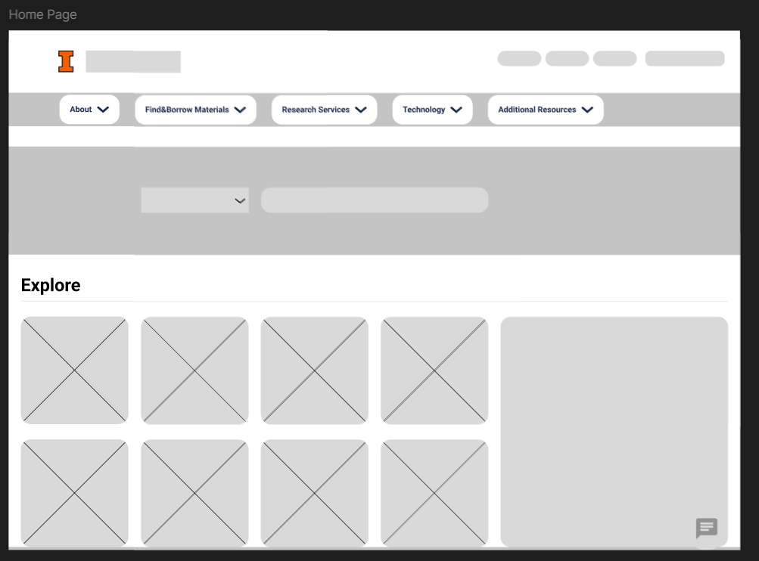
Lo-fi Wireframe
Home Page

Slide 17
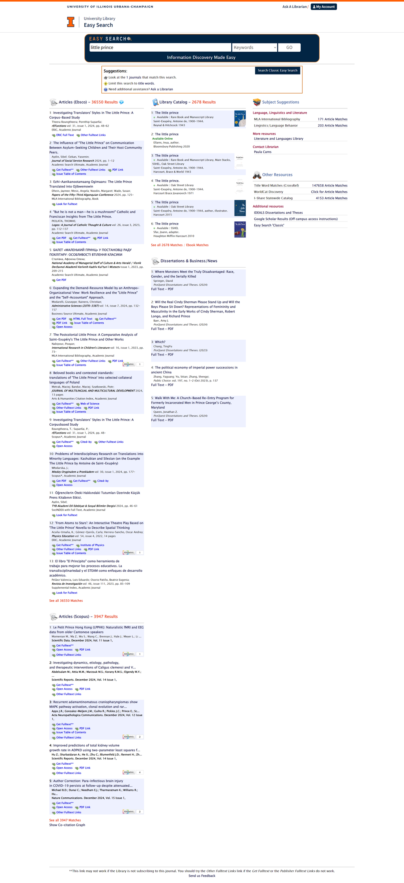
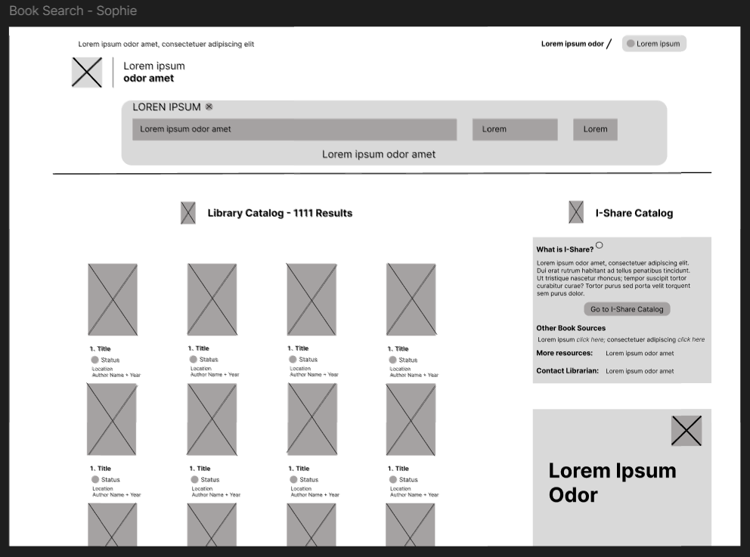
Lo-fi Wireframe
Book Search Page

Slide 18
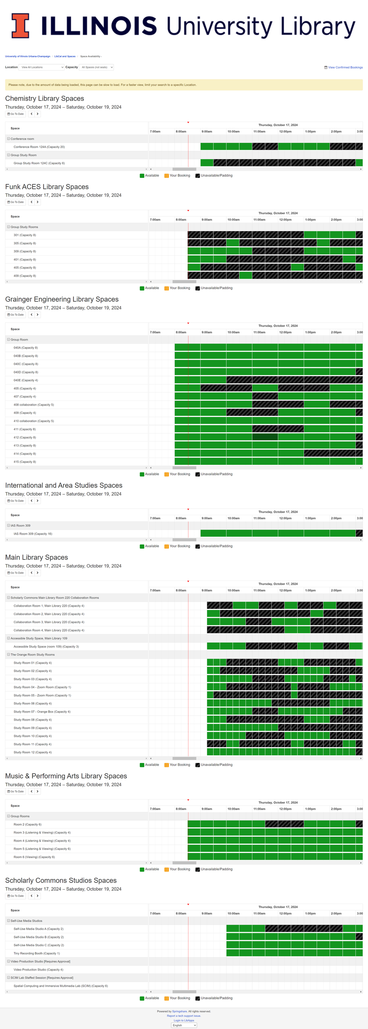
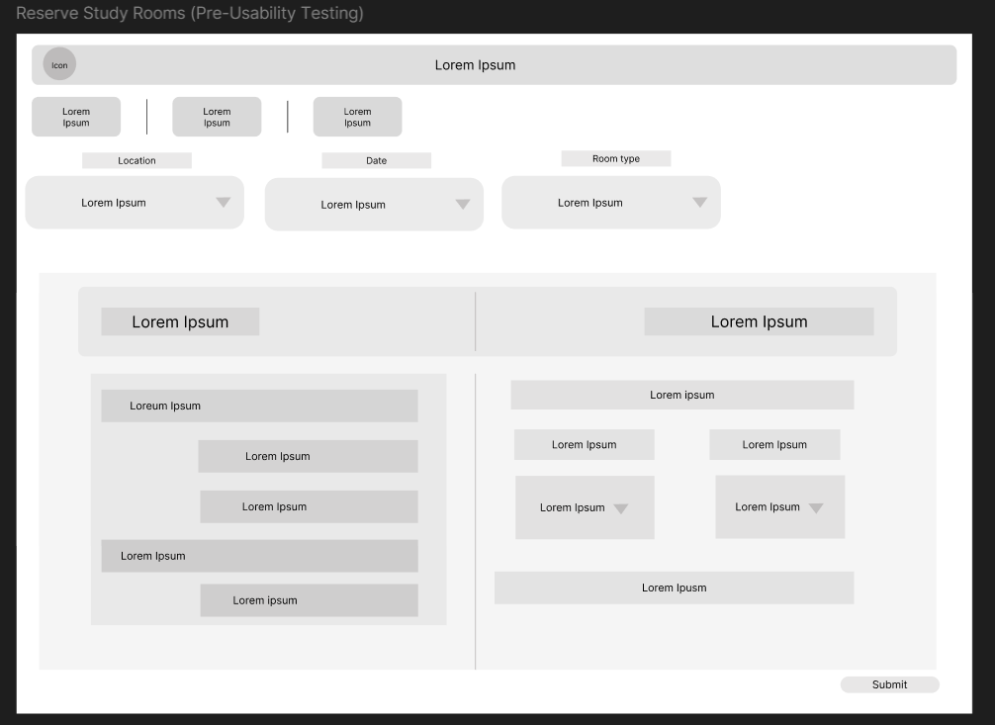
Lo-fi Wireframe
Reserve Study Rooms Page

Slide 19



Iteration - Feedback
User 1
Role: Participated in both initial interviews and wireframe testing
Liked the simplified search and clear books status availability with book cover pictures.
Found certain sections overcrowded and the additional information below each book could be enlarged.
User 2
Role: Brought in exclusively for wireframe testing.
Liked the simplified search and additional drop-down options.
Liked the old visual availability indicators but the time slots could be more prominent and straight-forward.

Slide 20
Final Mockups
Our main focus is to simplify the user experience.
Simplify Elements
Change the UX to modern style
Clear Visual Aspects

Slide 21
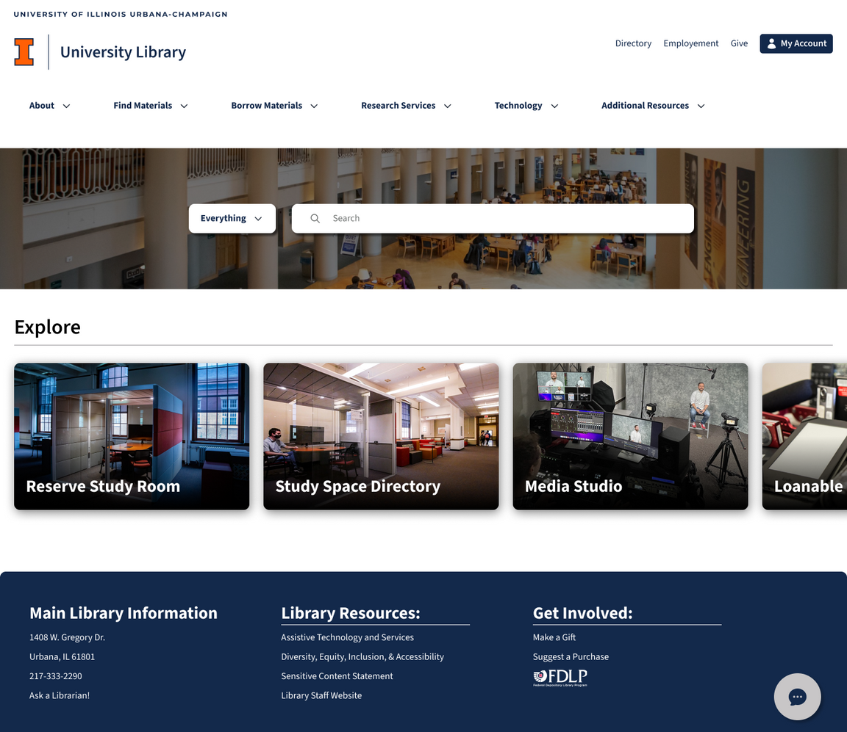

Slide 22
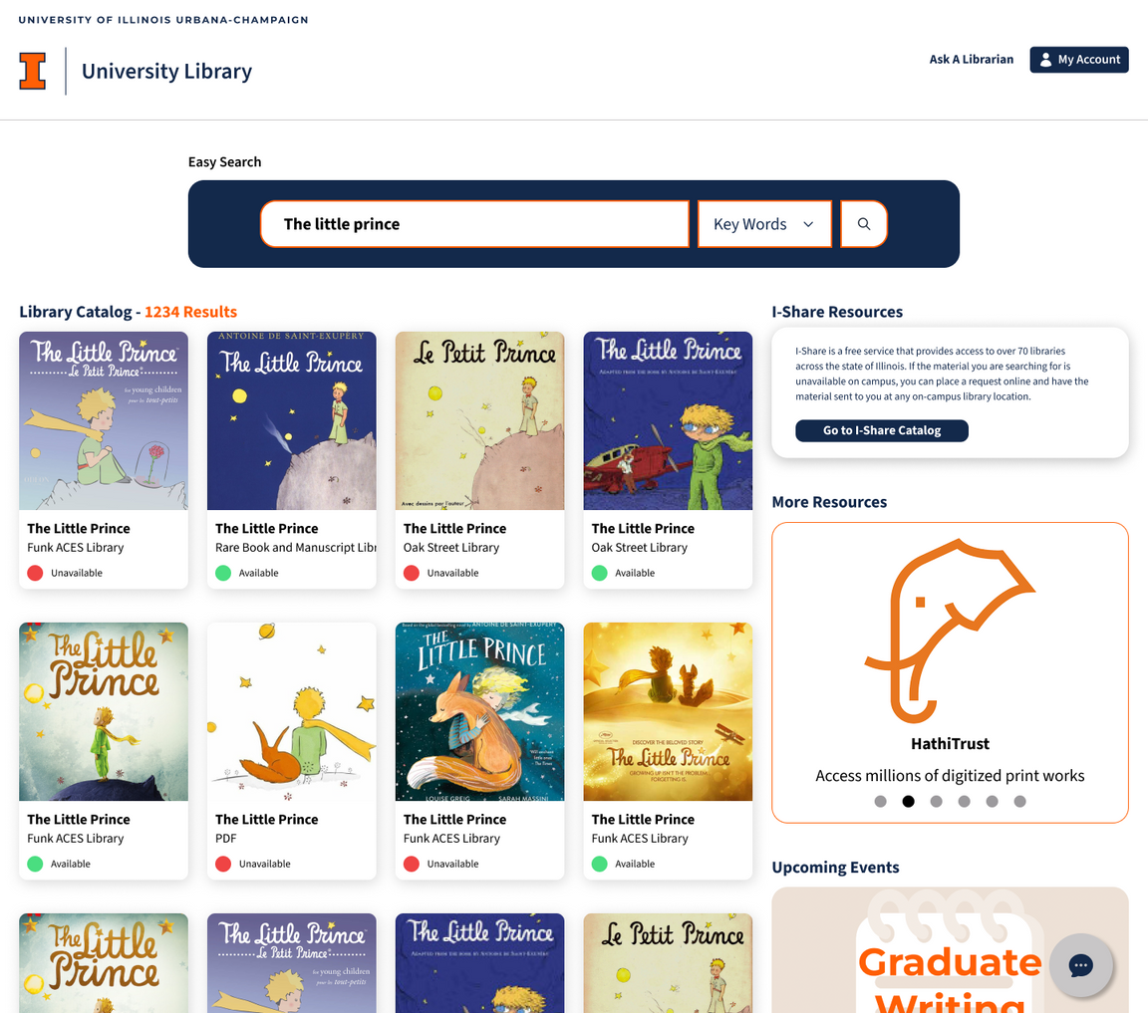

Slide 23
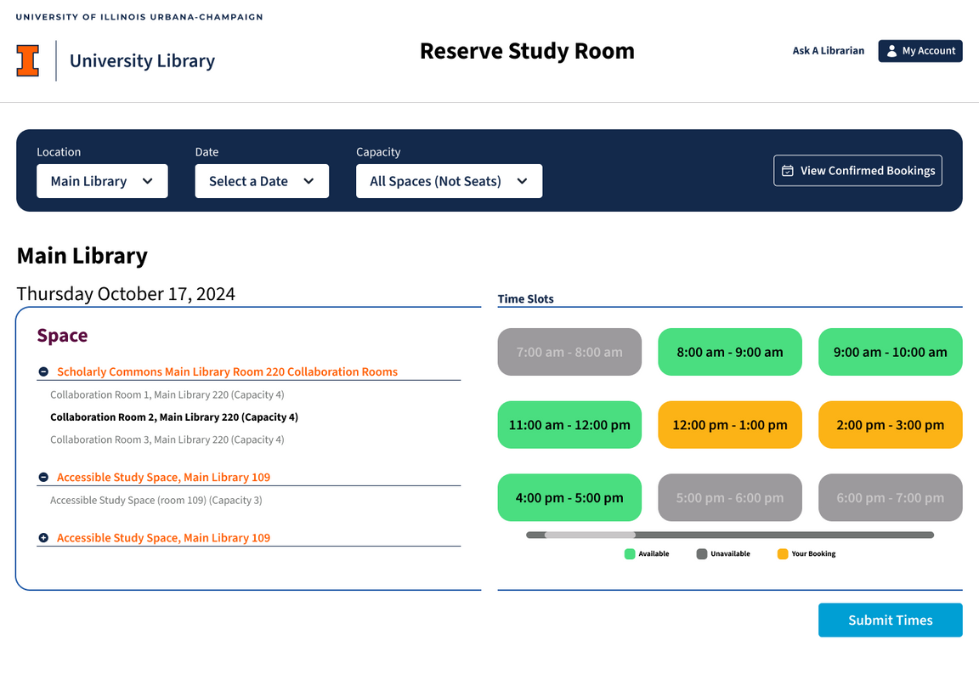

Slide 24




Road Map
Bring new accessible medium such as mobile app
Collect user feedback about the new website
Develop the UX including new and old users.
Advertise the library website to gain new users

Slide 25
Thanks!

